Slide 1

Globanova: Affordable Learning & Smart Dropshipping
Presented by: SAIF SIAM (ID: 20244103238), Hujaifa (ID: 20244103241),
ABIR (ID:20244103212),TRILOY(ID:20244103219),PIAL(20244103216)
SECTION: 6 INTAKE: 54
TRAGIC BYTES

Slide 2

Agenda
Objectives & Goals
Problem Statement
Problem Solution
Market Analysis
Business Model
Start-up Plan
Revenue Generation
Conclusion
TRAGIC BYTES

Slide 3

Objectives & Goals
Empower Students
Support Entrepreneurs
Provide discounted access to quality international courses.
Offer AI-driven tools for spotting profitable dropshipping products.
TRAGIC BYTES

Slide 4

Problem Statement
High Course Costs
Product Discovery Challenges
Block access to international education in developing regions.
Difficult for dropshippers to find trending, profitable items.
Platform Gaps
Existing solutions focus on either education or e-commerce, not both.
TRAGIC BYTES

Slide 5

Globanova's Solutions
Discounted Course Reselling
AI-Powered Product Discovery
Premium courses 60%+ off from Udemy, Coursera, edX
Real-time data analysis for trending products
Certificates, offline access, mentor sessions bundled monthly
Competitor analysis, price tracking, supplier verification
Subscription model with browser extension and dashboard
TRAGIC BYTES

Slide 6
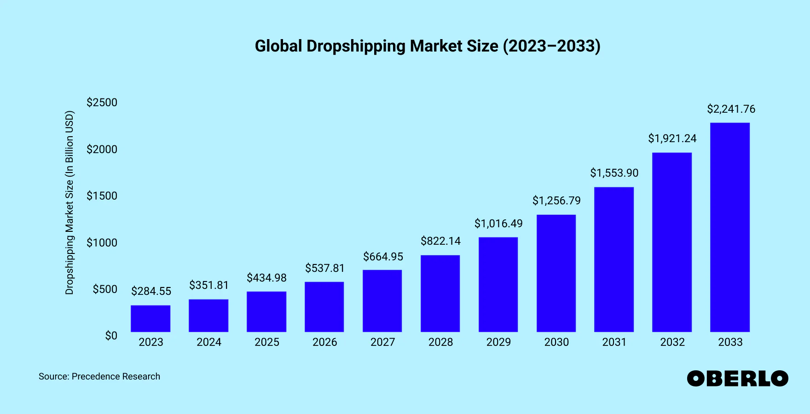
Market Analysis
Target Customers
Students in South Asia & Africa seeking affordable education
Digital entrepreneurs launching e-commerce stores
Freelancers & developers upgrading skills
Small business owners scaling with low investment
TRAGIC BYTES

Slide 7

Business Model
Dual Functionality
Revenue Streams
Education via course sales and subscriptions; E-commerce with AI dropshipping tools.
Monthly subscription
One-time course bundles
Affiliate commissions from partners
TRAGIC BYTES

Slide 8

Start-up Plan
Manpower Needs
AI Engineers
Web Developers
UI/UX Designers
Marketers & Support
Budget Allocation
40% Product Development
30% Marketing & Outreach
20% Operations & Logistics
10% Miscellaneous/Buffer
TRAGIC BYTES

Slide 9
Revenue Generation
Current Strategy
Future Plans
Monthly plan : unlimited course & dropshipping tool access
Commission partnerships with providers and suppliers
Tiered pricing based on feature sets
10-month package : extra mentorship, webinars, certificates
Payment gateway & e-wallet integrations
TRAGIC BYTES

Slide 10



Conclusion
Enable Intelligent Commerce
2
Leverage AI for smarter dropshipping choices.
Democratize Education
Break barriers to quality international learning.
1
Scale & Community
3
Build a global, mission-driven ecosystem.
TRAGIC BYTES

Slide 11

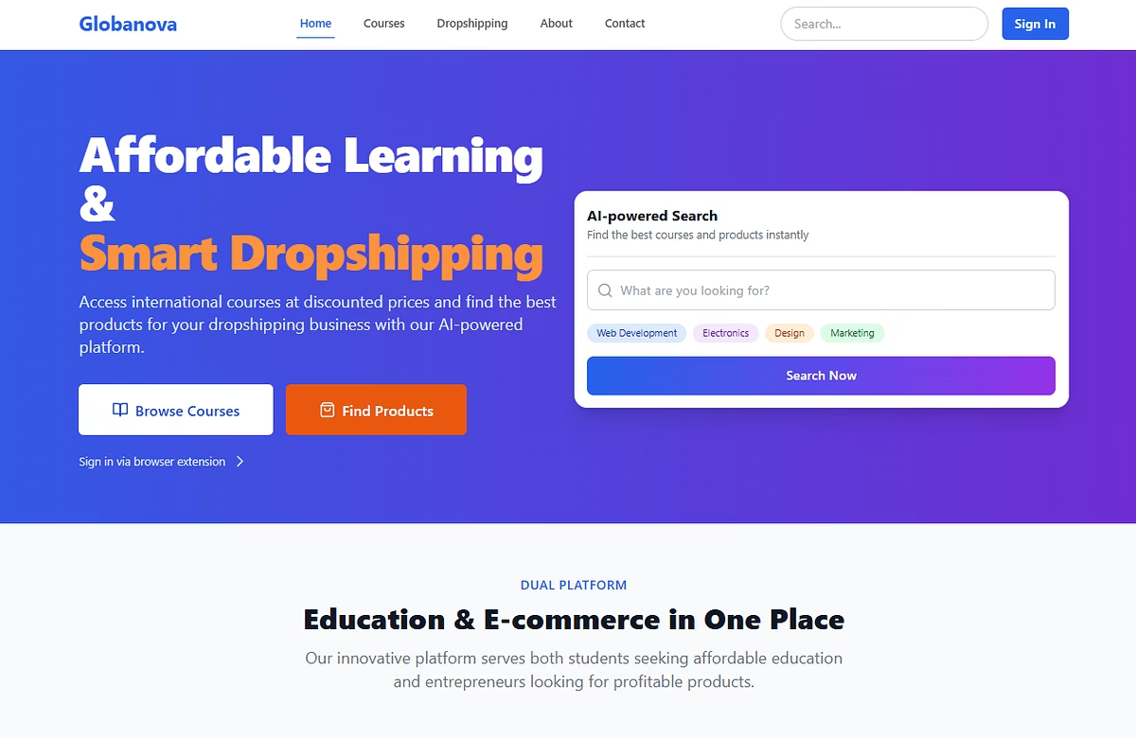

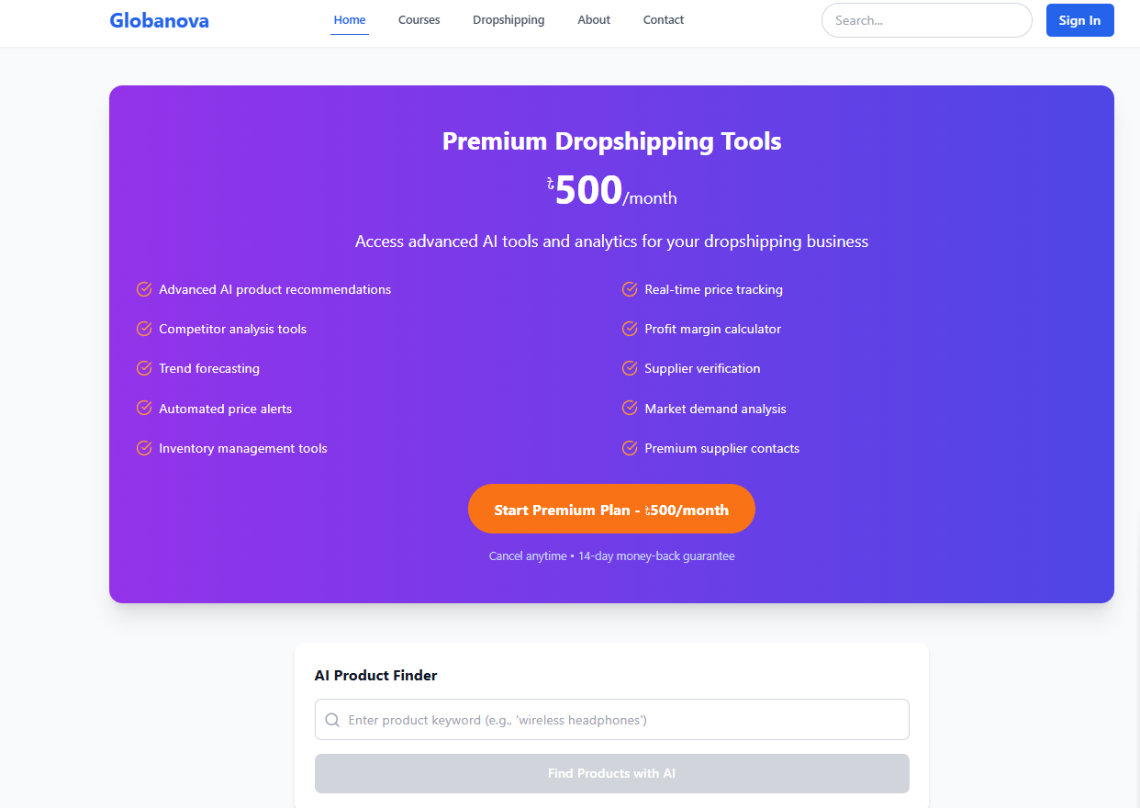
Experience Globanova Live
Explore our demo website for a hands-on view of Globanova's features.
See how affordable courses and AI-driven dropshipping tools integrate seamlessly.
Navigate an intuitive interface designed for students and entrepreneurs alike.
Visit https://profound-fudge-dd642f.netlify.app/ and discover the future of learning and commerce.
TRAGIC BYTES

